Slide 1

Raspberry Pi Sound Board
UTA EE Lab Workshops

Slide 2
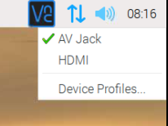


Ensure Audio is selected to AV Jack
Right Click the speaker icon in the upper right corner and select AV Jack.
Open the File Explorer and go to the pi directory. Create a folder named soundboard.
Goto ->Programming -> Geany.
In Geany, select file-> new. Save the new file as soundboard.py and save it to Home/Pi/Soundboard directory.

Slide 3
Type in the following code
import pygame.mixer from time import sleep import RPi.GPIO as GPIO from sys import exit GPIO.setmode(GPIO.BCM) GPIO.setup(23, GPIO.IN) GPIO.setup(24, GPIO.IN) GPIO.setup(25, GPIO.IN) pygame.mixer.init(48000, -16, 1, 1024) sndA = pygame.mixer.Sound(“Horse.wav") sndB = pygame.mixer.Sound(“Dog.wav") sndC = pygame.mixer.Sound(“Drum.wav") soundChannelA = pygame.mixer.Channel(1) soundChannelB = pygame.mixer.Channel(2) soundChannelC = pygame.mixer.Channel(3)
print "Sampler Ready." while True: try: if (GPIO.input(23) == True): soundChannelA.play(sndA) if (GPIO.input(24) == True): soundChannelB.play(sndB) if (GPIO.input(25) == True): soundChannelC.play(sndC) sleep(.01) except KeyboardInterrupt: exit()

Slide 4
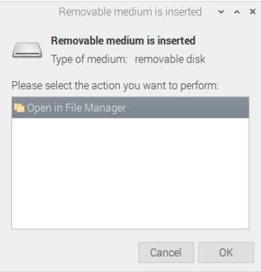
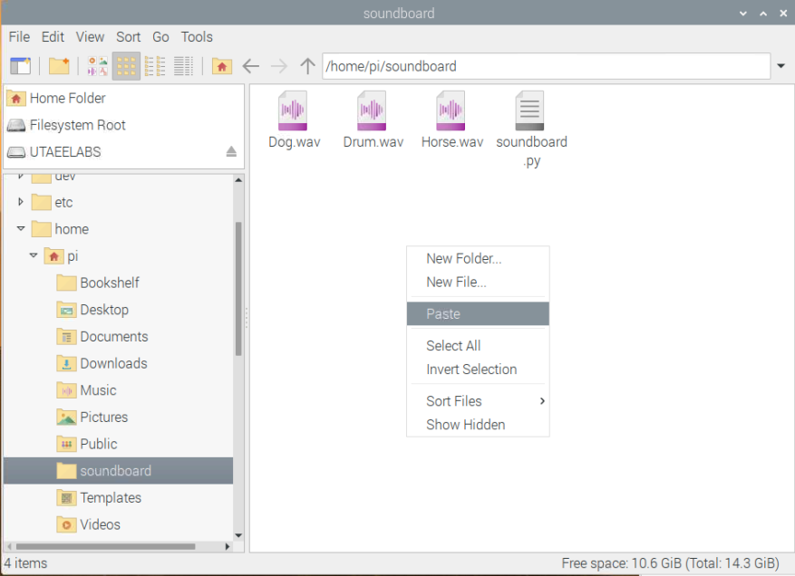
Add the .wav files
Open in File manager and copy to the soundboard directory

Slide 5
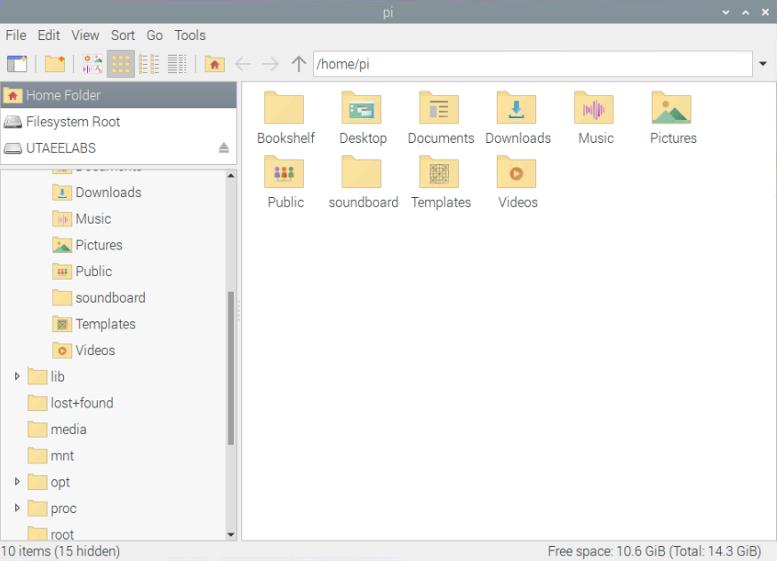
Eject the USB Drive properly
We are sharing the USB drive.

Slide 6
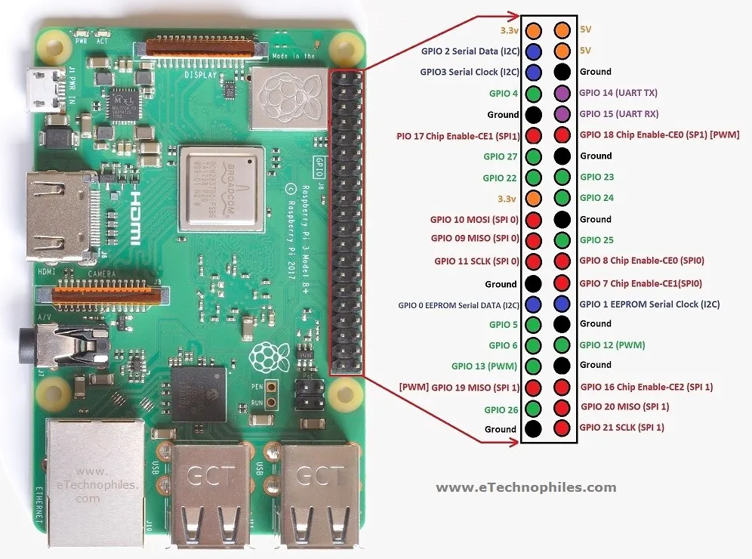
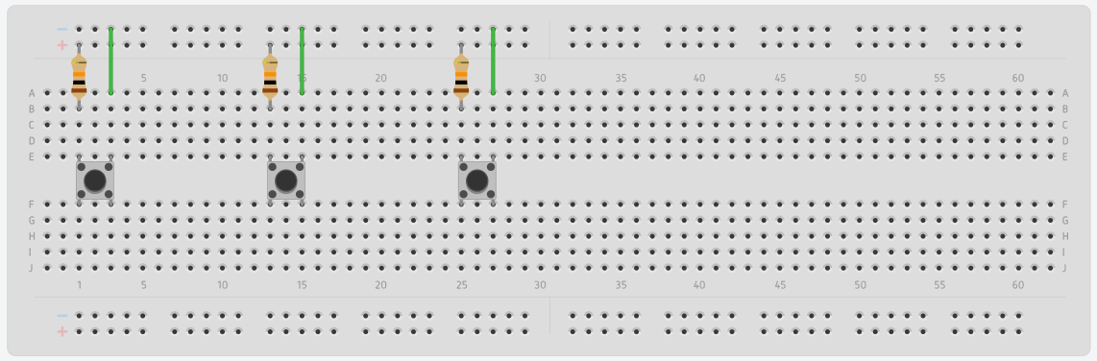
GPIO 23,24,25 3.3V and Ground

Slide 7
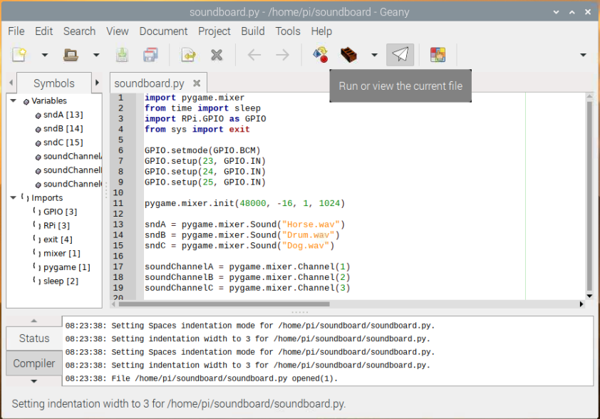
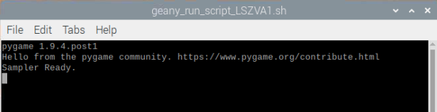
Run your program
A command window should open if the
Program is working
Push the buttons to play the sound.
Press CTRL + C to exit

Slide 8
Find some other sound files and edit your code to play them.
Try using ffmpeg -i input.mp3 output.wav in the terminal to convert mp3’s to wav files.
Try using lame --decode yourfile.mp3 yourfile.wav in the terminal to convert mp3’s to wav files.

Slide 9
Clean up your Pi
Set the Audio Output back to HDMI
Delete the wav files and program
Delete the soundboard folder.
Return breadboards, parts, Pi’s, network cables, etc

